Slide 1
HBASE & DEEPDIVE
AMARNATH KALLAM

Slide 2
A Hadoop cluster is a batch processing framework of immutable ﬁles.
It does not support random read/write functions and is best suited for oﬄine batch processing.
HBase is a very speciﬁc use case within Hadoop.
It runs on a Hadoop cluster and uses HDFS for storage and provides a low latency updateable record store by enabling random, real-time read/write access to Big Data.
HBase hosts very large tables – billions of rows times millions of columns – atop clusters of commodity hardware.
HDFS provides fault tolerant storage.

Slide 3
Dynamic Schema Scales Horizontally to PB of Data Directly Integrated with Hadoop.
HBase is integrated with YARN and analytics are in place using Hive, Pig, Spark and more.
Apache HBase is a non-relational database, sometimes referred to as a NoSQL database.
HBase was created for hosting very large tables with billions of rows and millions of columns.
HBase adds some transactional capabilities to Hadoop, allowing users to conduct table inserts, updates, scans, and deletes.
HBase is best suited for online analytical processing and has limited feature support for online transactional processing.

Slide 4
HBase features include:
Linear and modular scalability
Strictly consistent reads and writes
Automatic and conﬁgurable table sharing
Automatic failover support between Region Servers
Convenient base classes for backing Hadoop MapReduce jobs with Apache HBase tables
Easy to use Java API for client access
Block cache and Bloom Filters for real-time queries and query predicate push down via server side Filters
Thrift gateway and a REST-ful Web service that supports XML, Protobuf, and binary data encoding options

Slide 5
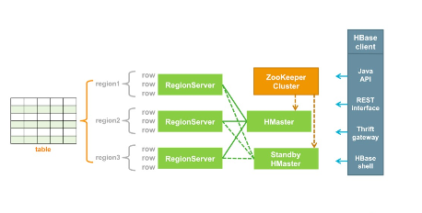
HBase Components & ARCHITECTURE
Each cluster node contains a portion of a table called a region.
Each region contains some number of table rows.
Regions are the physical mechanism used to distribute read and write operations across the cluster.
Initially a small table might consist of a single region.

Slide 6
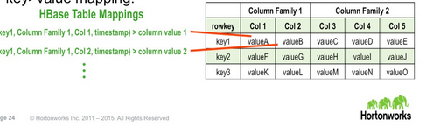
However, regions are automatically split and re-distributed as the amount of data grows.
Table splits can also be deﬁned by the table administrator, if necessary, for performance or scalability reasons.
HBase capacity expands by adding more cluster nodes.
Each region is managed by a RegionServer service.
RegionServers typically run on the same machines that run the Hadoop distributed ﬁle system DataNode service.
Hadoop and HBase clusters often overlap by using the same machines

Slide 7
Key-Value Mappings
HBase contains maps of keys and their values. If you know the key you can retrieve the value.
Each table contains a diﬀerent set of key-value mappings and each key has multiple parts.
Each key consists of a column family name, rowID, column qualiﬁer, and a timestamp
One or more column families are conﬁgured, or declared, by a user when a table is created.
Values in the same column family are stored together on disk.
Column families deﬁne the storage properties for a group of columns.
Properties include such things as compression, the number of versions to maintain, and time-to-live values for deleted data

Slide 8
The rowID is used to access data and divide table data into regions.
Each region consists of a sorted range of rowIDs. HBase clients can retrieve a single value using a single key or all values for which the key is between a range of of X and Y.
Regions are maintained on separate RegionServer nodes.
A column qualiﬁer is a column name, which is just a label within the multi-part key. It is assigned by an application. It is used to help identify a speciﬁc piece of data in a row. In any given row, one or more columns might or might not exist.
Timestamps are used to version the data and support data updates.
Every value in a row has its own timestamp.
This means that each value in a row, rather than an entire row, is versioned.
Writes to HBase are guaranteed to be atomic which means that a reader will always read the last written value.
Readers can request any available version of the data.

Slide 9
Rows and Columns
Rows and columns in HBase are implemented diﬀerently than rows and columns in most relational databases.
A multi-part key identiﬁes a speciﬁc cell with a value. Cells are conceptually illustrated as a row-column intersection.
Because an HBase table is just a set of key-value mappings, a row is really nothing more than just a logical collection of values that share the same row key.
A column is just an additional label for a value and is included in the multi-part key.
HBase tables can be sparse: HBase does not require a mapping for every cell which means that it is possible for cells to be empty or null.
Unlike a null cell in most relational databases, a null cell in HBase does not require storage space.
A null cell simply does not exist because there is no key-value mapping for it.

Slide 10
Apache Phoenix is not part of HBase.
Phoenix is an SQL skin over HBase that provides direct, low-latency access to HBase.
Entirely written in Java, Phoenix enables querying and managing HBase tables using SQL commands.
Apache Phoenix takes your SQL query, compiles it into a series of HBase scans, and orchestrates the running of those scans to produce regular JDBC result sets.
Phoenix works with existing HBase tables or can be used to create new HBase tables.
The table metadata necessary to support SQL-like operation is stored in a companion HBase table and is versioned, such that snapshot queries over prior versions will automatically use the correct schema.
Phoenix allows people to reuse their SQL skills in an HBase environment. However, Phoenix only changes the user interface. It does not change the way HBase operates.
Use cases that are not suitable for HBase are not suitable for Phoenix over HBase.
Phoenix is useful is because it oﬀers a higher-level language abstraction over HBase commands. You can typically enter fewer Phoenix commands to achieve the same output results.
Phoenix vs. Hive: Direct use of the HBase API, along with coprocessors and custom ﬁlters, results in performance on the order of milliseconds for small queries or seconds for tens of millions of rows. This is in contrast to Apache Hive which can also be used to access HBase data using SQL, but uses traditional MapReduce batch processing.
For more information see: Phoenix.apache.org.

Slide 11
Hbase Hands-on :-
Launch Hbase shell
hbase shell
Version of Hbase
Hbase > version
Status of Hbase
hbase> status hbase> status
hbase> status 'detailed‘
What user you are connected to
hbase> whoami
Create a Table
hbase> create 't1','cf1‘
List tables
list
Put some data in the table using the put command
hbase> put 't1', '1','cf1:name','yourname'

Slide 12
Scan the table using the scan command
hbase> scan 't1'
Add another row
hbase> put 't1', '2','cf1:name','theRainInSpain'
Change your name
hbase> put 't1', '1','cf1:name','your_new_name‘
Drop the table
hbase> disable 't1‘
hbase> drop 't1‘
Create a table that stores more than one version of a column
hbase> create 't1', {NAME => 'f1', VERSIONS => 2}
This creates table t1, with column family f1 and any data stored in column family f1 will be permitted to have up to 2 versions. Versions beyond 2 will be deleted oldest first
Insert multiple versions of a column.
hbase> put 't1','1', 'f1:name','name1'
hbase> put 't1','1', 'f1:name','name2‘
Scan the table requesting multiple versions (note different timestamps)
hbase> scan 't1',{VERSIONS => 2}

Slide 13
Add a third value for the column identifier f1:name
hbase> put 't1','1', 'f1:name','name3‘
Scan again
hbase> scan 't1',{VERSIONS => 2}
hbase> scan 't1',{VERSIONS => 3}
Gets vs. Scans:
If the table is large, the scan operation uses a lot of resources.
Hbase was designed for the optimal lookup to be a single row get.
Get :- retrieves a row or a subset of a row
PUT :- Add or update a row or a subset of a row
Scan :- retrieve a range of sequential rows
Delete :- remove a row or a subset of a row

Slide 14
HBase Data Model:-
In a row-oriented data store, a row is a unit of data that is read or written together.
In a column-oriented data store, the data in a column is stored together and hence quickly retrieved.
Row-oriented data stores:
Data is stored and retrieved one row at a time and hence could read unnecessary data if only some of the data in a row is required.
Typical compression mechanisms provide less eﬀective results than those on column- oriented data stores.
Not eﬃcient in performing operations applicable to the entire dataset and hence aggregation is an expensive operation.
Well suited for OLTP systems.
Easy to read and write records
Column-oriented data stores:
Data is stored and retrieved in columns and hence can read only relevant data if only some data is required.
Permits high compression rates due to few distinct values in columns.
Can eﬃciently perform operations applicable to the entire dataset and hence enables aggregation over many rows and columns.
Read and Write are typically slower operations.
Well suited for OLAP systems

Slide 15
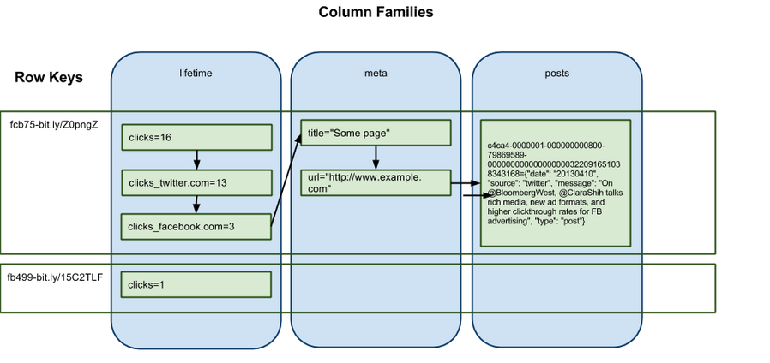
HBase Tables :-
Schema design in NoSQL is very diﬀerent from schema design in an RDBMS.
HBase tables are made of rows and columns.
All columns in HBase belong to a particular column family.
Table cells -- the intersection of row and column coordinates -- are versioned.
A cell’s content is an uninterrupted array of bytes.

Slide 16
Rows in HBase tables are sorted by row key. The sort is byte-ordered. All table accesses are via the table row key -- its primary key
Each row is basically a linked list, ordered by column family and then column name.
This is how it's laid down on disk, as well. Missing columns are free, because there is no space on disk pre-allocated to a null column.
Given that, it's reasonable to design a schema where rows have hundreds or thousands of columns.
Row keys are the single most important aspect of an HBase table design and determine how your application will interact with the HBase tables . They also aﬀect the performance you can extract out of HBase .

Slide 17
HBase tables are ﬂexible, and you can store anything in the form of byte[ ].
Store everything with similar access patterns in the same column family.
Indexing is only done for the Keys . Use this to your advantage.
Tall tables can potentially allow you faster and simpler operations, but you trade oﬀ atomicity . Wide tables, where each row has lots of columns, allow for atomicity at the row level .
Think how you can accomplish your access patterns in single API calls rather than multiple API calls .
HBase does not have cross-row transactions, and you want to avoid building that logic in your client code .
Column qualiﬁers can be used to store data, just like the cells themselves

Slide 18
Hashing allows for ﬁxed length keys and better distribution but takes away the ordering implied by using strings as keys.
The length of the column qualiﬁers impact the storage footprint since you can put data in them .
Length also aﬀects the disk and network I/O cost when the data is accessed.
The length of the column family name impacts the size of data sent over the wire to the client (in KeyValue objects).

Slide 19
HBase Data Model
In HBase, data is stored in tables, which have rows and columns.
This is a terminology overlap with relational databases (RDBMSs), but this is not a helpful analogy.
Instead, it can be helpful to think of an HBase table as a multi-dimensional map.
Table: An HBase table consists of multiple rows.
Row: A row in HBase consists of a row key and one or more columns with values associated with them.
Rows are sorted alphabetically by the row key as they are stored. For this reason, the design of the row key is very important.
The goal is to store data in such a way that related rows are near each other. A common row key pattern is a website domain.
Column: A column in HBase consists of a column family and a column qualiﬁer, which are delimited by a : (colon) character

Slide 20
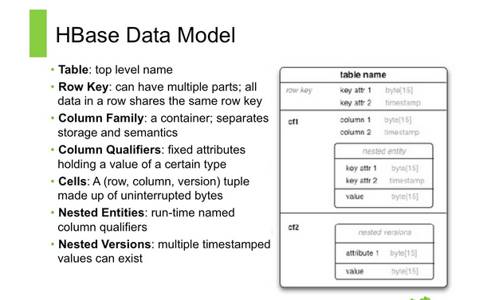
Column Family: Column families physically collocate a set of columns and their values, oSen for performance reasons.
Column Qualiﬁer: A column qualiﬁer is added to a column family to provide the index for a given piece of data.
Given a column family content, a column qualiﬁer might be content:html, and another might be content:pdf.
Though column families are ﬁxed at table creation, column qualiﬁers are mutable and may diﬀer greatly between rows
Cell: A cell is a combination of row, column family, and column qualiﬁer, and contains a value and a timestamp, which represents the value’s version.
Timestamp: A timestamp is written alongside each value, and is the identiﬁer for a given version of a value.
By default, the timestamp represents the time on the RegionServer when the data was written, but you can specify a diﬀerent timestamp value

Slide 21
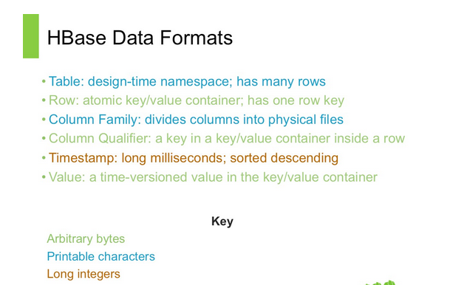
HBase Data Formats :-
The easiest and most naive way to describe HBase’s data model is in the form of tables, consisting of rows and columns .
This is likely what you are familiar with in relational databases . But that’s where the similarity between RDBMS data models and HBase ends . In fact, even the concepts of rows and columns is slightly diﬀerent .

